Slide 1
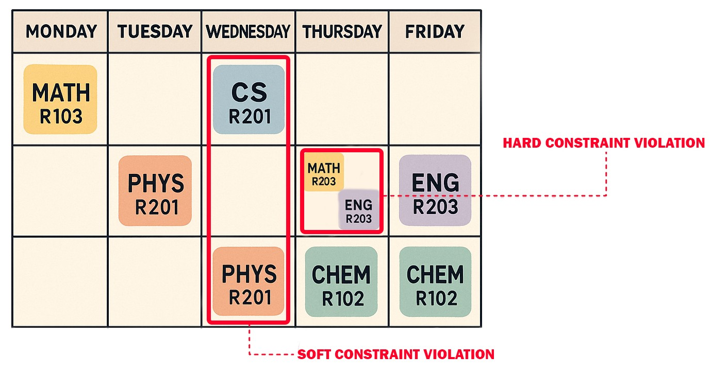
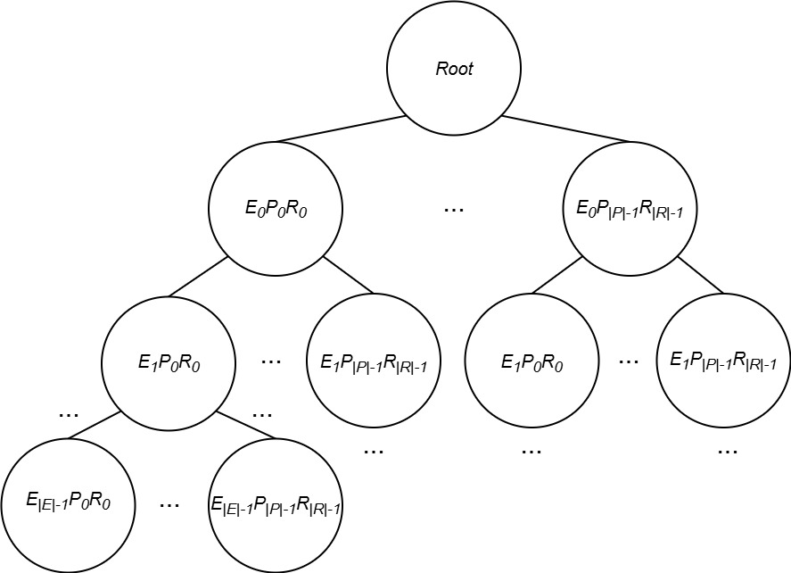
Improved Monte Carlo Tree Search for University Course Timetabling
Problem Context
Methodology
Key Findings
University Course Timetabling Problem (UCTTP)
Complex combinatorial optimization problem that consists of allocating events, rooms, lecturers, and students to weekly schedules while meeting hard and soft constraints.
Monte Carlo Tree Search (MCTS)
(Selection, Expansion, Simulation, Backpropagation)
Consistently finds feasible solutions in the challenging ITC-2007 set of benchmark instances
Hill Climbing (HC)
Local search algorithm to improve MCTS simulation phase feasible timetables.
Diving
Enables the algorithm to follow and deepen promising paths, aiming to improve the convergence speed and solution quality.
Random simulations failed to produce feasible solutions, emphasizing the importance of guided search and domain knowledge.
Tested C values (0.1 to 1000) in the UCT formula and in a modified version showed minimal impact on results
Although solution quality was below the best-known results, the approach shows solid potential with room for improvement
Monte Carlo Tree Search and its hybridization remain unexplored in the context of Curriculum-based Course Timetabling (a variant of UCTTP that focuses on course scheduling), making this the main goal of our work.

